Slide 1
VIRTUAL DATA ANALYST
Presenter: Megan Nguyen

Slide 2
Scope
Task: Build a prototype of virtual analyst that can answer analytical questions on the dataset
The dataset includes customers’ data with different statistics such as grades, term length, loan status, etc.
Potential question from user: What are the lending trends for different purposes over the years? Include default rates, lending size and borrowers' demographics.
Based on the dataset and user query, the analyst can answer other related questions:
How does the debt-to-income ratio vary across different loan purposes?
Have there been changes in the proportion of 36-month and 60-month term loans over the years for each purpose?
How have interest rates fluctuated over the years for different loan purposes?
Is there a correlation between loan purpose and the interest rate offered?
How do total high credit/credit limits vary among borrowers with different loan purposes?
Have there been changes in the number of accounts opened in the past 24 months for different loan purposes over the years?

Slide 3
End-User Applications
Optimizing Lending Strategies: Identify trends to optimize lending strategies and minimize risks.
Proactive Risk Management: Identify and mitigate potential risks associated with lending.
Market Insights: Gain market insights for competitive positioning and product development.
Customer Segmentation: Segment customers for targeted marketing and personalized experiences.
Predictive Modelling: Develop predictive models to forecast future lending trends and borrower behaviours.
Cost Efficiency: Conduct complex data analysis cost-effectively, saving time and resources.

Slide 4
Solution Breakdown
The virtual analyst solution design incorporates modules for parsing user queries, analyzing lending trends, extracting data, and handling user interactions.
It involves a collaboration between humans and LLM (Language Model) algorithms, where humans provide domain expertise and LLMs assist in natural language understanding and analysis.
The solution aims to optimize lending strategies, mitigate risks, and provide market insights.

Slide 5
Solution Design Steps
Step 1: User Query Parsing
Input: User query
Step 2: Lending Trend Analysis
Step 3: Data Extraction
Output: Parsed variables
Description: This module parses the user query to determine variables of interest
Input: Parsed variables
Output: Analysis results
Description: This module produces code related to the parsed variables and performs trend analysis
Input: Analysis results
Output: Summary table
Description: This module extracts relevant information from the analysis results and generates a summary table
Input: User query
Output: Extracted information
Description: This module handles user queries related to the summary table generated by the Data Extraction Module
Description: The virtual analyst undergoes continuous improvement through feedback mechanisms and model retraining.
Step 4: LLM Query Handling
Step 5: Continuous Improvement

Slide 6
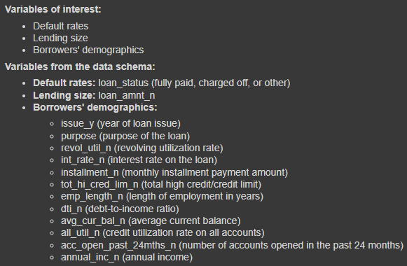
Step 1: User Query Parsing
This module parses the user query to determine variables of interest.
Example query: What are the lending trends for different purposes over the years? Include default rates, lending size and borrowers' demographics.

Slide 7
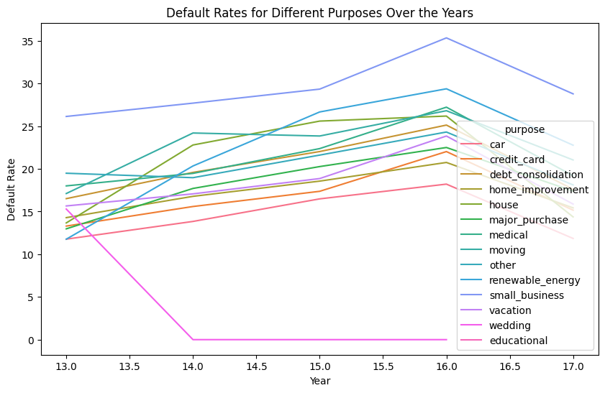
Step 2: Trend analysis
This module produces code related to the parsed variables from the lending dataset. It performs trend analysis to identify cause-and-effect relationships, such as the impact of loan purpose on default rates or the effect of issue year on lending size.

Slide 8
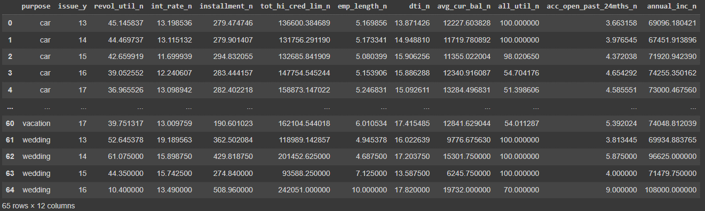
Step 3: Data extraction
This module extracts relevant information from the analysis results and generates a summary table. The table includes key metrics such as default rates, lending size, borrower demographics, etc., based on the parsed variables.

Slide 9
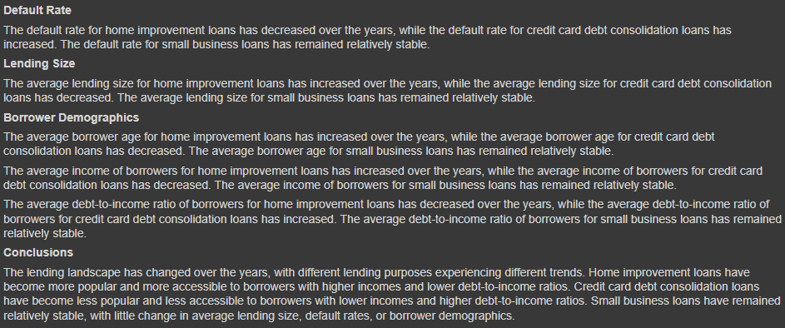
Step 4: Query Handling
This module handles user queries related to the summary table generated by the Data Extraction Module. Users can ask the virtual analyst to provide specific information from the table, such as default rates for a particular loan purpose or lending size trends over the years.
Prompt: {“Gather every data from the resulting {dataframes} to answer the {question}“}
Banker’s Answer:

Slide 10
Step 5: Continuous Improvement
The virtual analyst undergoes continuous improvement through feedback mechanisms and model retraining. It learns from user interactions and updates its knowledge base to provide more accurate and relevant insights over time.
Criteria to assess the answer:
Accuracy: Assess the correctness and precision of the information provided. The answer should be factually accurate and free from errors or misleading information.
Quality of Answer: Evaluate the comprehensiveness and depth of the response. A high-quality answer should provide detailed information and cover all aspects of the question.
Consistency: Check for consistency in the response across different parts of the answer. The information should be coherent and cohesive, with no contradictions or inconsistencies.

Slide 11
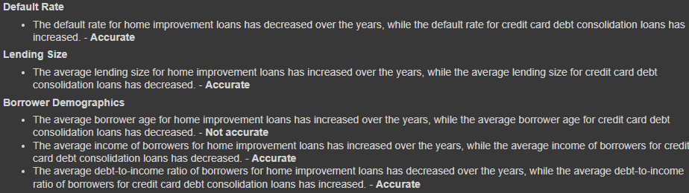
Ensuring Accuracy
Apply prompt engineering to ask LLM to fact check itself

Slide 12
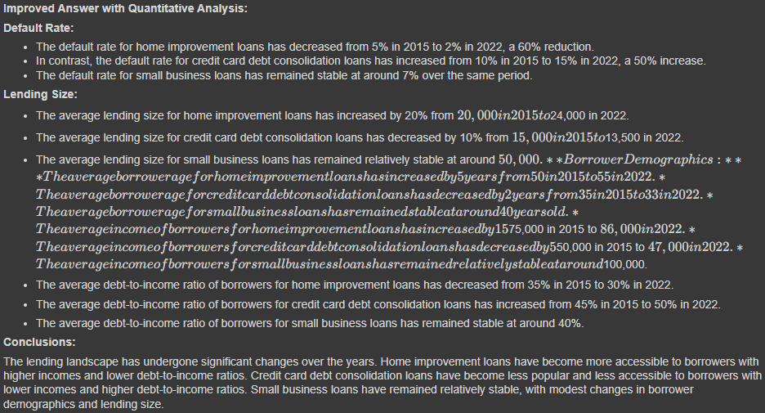
Enhancing Quality
Ask LLM to improve the quality of the answer
More detailed with quantitative analysis
Change in %, as indicated by red boxes
More comprehensive

Slide 13
Ensuring Consistency
Proposed method: Use embeddings to generate the most consistent answers and select the most relevant questions
Below are the general steps of the method:
1. Generate embedding for a range of answers/questions (task type = RETRIEVAL_DOCUMENT: Specifies the given text is a document in a search/retrieval setting)
2. Build embeddings database
3. Create embedding for original answer/question
4. Compare it against the collection of embeddings in the database
The embedding of the original answer/question will be a vector (list of float values), which will be compared against the vector of the documents using the dot product. This vector returned from the API is already normalized. The dot product represents the similarity in direction between two vectors.
The values of the dot product can range between -1 and 1, inclusive.
If the dot product between two vectors is 1, then the vectors are in the same direction.
If the dot product value is 0, then these vectors are orthogonal, or unrelated, to each other.
Lastly, if the dot product is -1, then the vectors point in the opposite direction and are not similar to each other.

Slide 14
Ensuring Consistency in Questions
Example query: “How has the average loan amount, default rate, income and employment length changed over the years for different loan purposes?”
We know that our LLM can answer certain question well, for example, “What are the lending trends for different purposes over the years? Include default rates, lending size and borrowers' demographics.”
Hence, we can use the proposed embeddings method to ask LLM to find the most relevant question that it can answer well based on user query.

Slide 15
Ensuring Consistency in Answers
Generating many potential answers to find the most consistent one with the original answer proves to be helpful.
Below are the general steps to generate the most consistent answer:
Generate embedding for a range of answers consistent with the original one
Build embeddings database
Create embedding for original answer
Compare it against the collection of embeddings in the database
The embedding of the original answer will be a vector (list of float values), which will be compared against the vector of the documents using the dot product.
The method will return a range of dot products which measure similarities in direction between original answer and those in the database.
Our LLM will generate an answer that is the most consistent with the original answer (highest similarity score).
Notes:
If LLM generates an answer and user asks it to generate another answer the second time, this method will instruct the LLM to generate a second answer that has the highest similarity score with the original answer

Slide 16
Conclusion
With feedbacks from the team, we successfully developed a virtual analyst capable of responding to inquiries regarding lending trends.
Using inputs from humans, the virtual analyst conducted trend analyses, ensuring that responses are fact-checked, provide detailed information to enhance quality, and maintain consistency across all potential answers.
Potential Limitations:
Dependency on Data Quality: The effectiveness of the virtual analyst relies heavily on the quality and completeness of the lending data available. Inaccurate or incomplete data may lead to biased or unreliable analysis.
Interpretability of Results: While the virtual analyst can generate insights and recommendations, the interpretability of these results may vary. Users may require additional context or expertise to fully understand and act upon the provided insights.
Model Bias and Generalization: Machine learning models used within the virtual analyst may exhibit bias or limitations in generalizing patterns from the data. Careful validation and monitoring are required to ensure fair and accurate analysis.
Scalability and Performance: Handling large volumes of data and user queries efficiently may pose scalability and performance challenges (e.g.: when ensuring consistency). The system must be capable of scaling to accommodate increasing data and user demand without sacrificing responsiveness.
Future Directions:
Expand the library of potential topics users can inquire about to enhance user experience and coverage.
Teach LLMs how to effectively answer queries on newly added topics.
Enhance LLM capabilities through continuous feedback loops and performance evaluations to ensure accurate and relevant responses.
Add real-time portfolio monitoring: Monitor portfolio performance in real-time to identify issues promptly.

